Slide 1
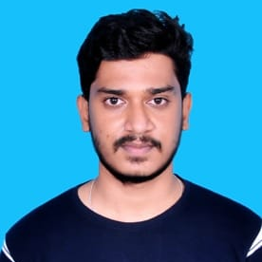


CHETHAN V
Analyst/Software Engineer
BACHELOR OF ENGINEERING
Telecommunication Engineering
2017-2021
Skills C#
.Net core
ADO. Net
ASP. Net Core MVC
LINQ
Entity Framework
MS-SQL
DatabaseL
MS SQL Server 2014
Web Technologies
HTML5
CSS3
Java Script
Bootstrap
AddOns
Github
Postman
Additional skills
Leadership Qualities
Quick Learner
Team Management
BANGALORE
chethan.a.v@capgemini.com
+91 9164696235
A4
Eager to work in a team of dedicated people and serve a key role in the enhancement and development of the project.
Software Engineer who is Strong in design and integration with intuitive problem-solving skills. Passionate about implementing and launching new projects.
Ready to learn new technologies and implement them to further improve my knowledge.
Hands on experience in creating microservices with C#,ASP.NET MVC Framework ,HTML5,CSS and SQL Server.
Online Medicine Donation System :
Completed end to end case study of Online Medicine Donation System along with JWT authentication , Postman, html, CSS, Bootstrap for user interface.
Microsoft Azure Fundementals Certificate :
Completed this course.
Check out my work on GitHub & Video Profile

